Slide 1


REDI 3x3 Presentation:
Data projects, Wage Inequality and Top Incomes
Martin Wittenberg
DataFirst
4 November 2014

Slide 2
Overview
Overview
DataFirst data projects
Wage and Wage Inequality Trends
Top earnings

Slide 3
Datafirst data projects
REDI 3x3 Presentation

Slide 4
What is DataFirst?
Data Projects
A data service based at UCT
Data dissemination
DataFirst portal (www.datafirst.uct.ac.za)
Survey data
Metadata
Searchable
Secure Data Research Centre
Data that is confidential/sensitive
NIDS geospatial data, UCT admissions data, CT RSC levy data…
Training
Research
Data quality
Harmonising data

Slide 5
REDI 3x3 data projects
Data Projects
Secure data projects
Tax data
QES data
Key issue for both is how to do this within the current legal framework; trust; worry that secure facility is based in CT
Harmonisation/data creation projects
SESE: Survey of Employers and the Self-employed, 4 surveys: 2001, 2005, 2009 and 2013
PALMS: Post-Apartheid Labour Market Series, v2
Contains employment, wages, some infrastructure
OHS: annual 1994-1999
LFS: biannual 2000-2007
QLFS: quarterly 2008-2012q.1
39 surveys, almost 3.8 million records

Slide 6
PALMS: What did we add?
Data Projects
Rename/redefine variables to be as consistent across time as possible
A set of harmonised weights
Real earnings series across time:
Changes in measurement
Dealing with outliers
Dealing with brackets/missing incomes

Slide 7
Harmonising weights
Data Projects
Why do we need to do this?
Problems with Stats SA weights
Branson & Wittenberg (2014)

Slide 8
Harmonising weights
Data Projects

Slide 9
Measurement changes
Data Projects
Lots of changes
Biggest - break between OHSs and LFSs
Two questions in OHSs (wages and earnings from self-employment; could answer both)
Only one question in LFSs
Coverage change between OHSs and LFSs
Big increase in low income earners
Mainly self-employed agricultural workers

Slide 10
Outliers –Millionaires (real terms)
Data Projects
 | unweighted |  | weighted |  |  | unweighted |  | weighted
Survey | n | prop | total | prop | Survey | n | prop | total | prop
1994 |  | 0 |  | 0 | 05:1 |  | 0 |  | 0
1995 | 2 | 0.000097 | 1 865 | 0.000211 | 05:2 | 4 | 0.000262 | 3 052 | 0.00031
1997 |  | 0 |  | 0 | 06:1 |  | 0 |  | 0
1998 | 10 | 0.001089 | 8 990 | 0.001048 | 06:2 |  | 0 |  | 0
1999 | 43 | 0.003576 | 27 570 | 0.003235 | 07:1 | 2 | 0.000117 | 824 | 0.000079
00:1 | 1 | 0.000174 | 614 | 0.000071 | 07:2 | 2 | 0.000125 | 2 794 | 0.000259
00:2 | 20 | 0.001049 | 14 357 | 0.001526 | 10:1 | 6 | 0.000334 | 3 678 | 0.000318
01:1 | 1 | 0.000059 | 86 | 9.70E-06 | 10:2 | 10 | 0.00056 | 6 277 | 0.000548
01:2 | 4 | 0.000247 | 2 466 | 0.000276 | 10:3 | 11 | 0.000644 | 7 511 | 0.000664
02:1 |  | 0 |  | 0 | 10:4 | 6 | 0.000358 | 3 611 | 0.000315
02:2 | 1 | 0.000068 | 2 441 | 0.000276 | 11:1 | 1 | 0.000061 | 1 041 | 0.000091
03:1 |  | 0 |  | 0 | 11:2 | 4 | 0.000243 | 3 737 | 0.000327
03:2 |  | 0 |  | 0 | 11:3 | 3 | 0.000173 | 1 937 | 0.000166
04:1 |  | 0 |  | 0 | 11:4 | 6 | 0.000335 | 2 647 | 0.000224
04:2 |  | 0 |  | 0

Slide 11
How do we deal with this?
Data Projects
Run (“Mincerian”) wage regression
Generate residuals (i.e. deviations from the predicted wage)
“Studentize” these
Flag residuals that are bigger than 5 in absolute value – should have seen 0.3 cases on a dataset as big as PALMS
Actually flagged 476
Outlier variable included with PALMS public release

Slide 12
Brackets (LFS case)
Data Projects
Salary category | 00:1 | 00:2 | 01:1 | 01:2 | 02:1 | 02:2 | 03:1 | 03:2
None | 0.001 | 0.000 | 0.000 | 0.000 | 0.000 | 0.000 | 0.000 | 0.000
R 1 - R 200 | 0.890 | 0.939 | 0.867 | 0.892 | 0.880 | 0.862 | 0.890 | 0.846
R 201 - R 500 | 0.877 | 0.922 | 0.889 | 0.855 | 0.864 | 0.872 | 0.873 | 0.857
R 501 - R 1 000 | 0.808 | 0.913 | 0.838 | 0.845 | 0.835 | 0.821 | 0.829 | 0.815
R 1 001 - R 1 500 | 0.703 | 0.845 | 0.765 | 0.733 | 0.717 | 0.710 | 0.737 | 0.680
R 1 501 - R 2 500 | 0.625 | 0.849 | 0.741 | 0.750 | 0.704 | 0.695 | 0.712 | 0.697
R 2 501 - R 3 500 | 0.526 | 0.849 | 0.662 | 0.655 | 0.594 | 0.600 | 0.609 | 0.577
R 3 501 - R 4 500 | 0.499 | 0.773 | 0.562 | 0.607 | 0.507 | 0.493 | 0.482 | 0.474
R 4 501 - R 6 000 | 0.513 | 0.777 | 0.580 | 0.611 | 0.518 | 0.523 | 0.492 | 0.455
R 6 001 - R 8 000 | 0.463 | 0.762 | 0.500 | 0.562 | 0.501 | 0.449 | 0.444 | 0.429
R 8 001 - R 11 000 | 0.473 | 0.661 | 0.464 | 0.448 | 0.398 | 0.383 | 0.372 | 0.336
R 11 001 - R 16 000 | 0.452 | 0.646 | 0.458 | 0.436 | 0.383 | 0.294 | 0.341 | 0.279
R 16 001 - R 30 000 | 0.336 | 0.668 | 0.398 | 0.338 | 0.401 | 0.272 | 0.303 | 0.297
R 30 000 or more | 0.704 | 0.918 | 0.712 | 0.649 | 0.519 | 0.535 | 0.610 | 0.465

Slide 13
How does one deal with this?
Data Projects
4 approaches:
Reweighting:
Let those giving Rand amounts “represent” missing incomes in the same bracket
Deterministic imputations
Midpoint, Mean, Conditional mean
Stochastic imputations
Hot deck
Match individuals to “similar” individuals (on covariates like gender, education etc.), copy income
Multiple stochastic imputation
Problem with stochastic imputation is that the value that is imputed is not actually measured, it is the true value plus some error
We need to take the variability associated with this into account
Do the stochastic imputation multiple times
Can take the uncertainty arising from the imputation into account

Slide 14
How does PALMS deal with this?
Data Projects
“Bracket weights”
Does the reweighting of point values to take the brackets into account
Multiple stochastic imputation
Released a dataset with 10 versions of real earnings

Slide 15
What do the adjustments do?
Data Projects
 | Point values only |  | Reweighted |  | Imputations (no outliers)
 | outliers | removed | outliers | removed | mean | midpt | hotdeck | multiple
 | (1) | (2) | (3) | (4) | (5) | (6) | (7) | (8)
1995 | 2620 | 2620.3 | 2793.6 | 2793.9 | 2793.9 | 2880.3 | 2815.6 | 3028.1
 | (54.73) | (54.74) | (59.33) | (59.34) | (53.15) | (57.47) | (54.32) | (66.63)
1997 | 2049.2 | 2050.1 | 2660 | 2660.9 | 2660.8 | 2653.7 | 2664.1 | 2867.5
 | (42.5) | (42.51) | (95.37) | (95.39) | (52.77) | (60.29) | (55.41) | (70.15)
1998 | 2174.5 | 2044.8 | 2826.8 | 2667.8 | 2684.8 | 2575 | 2675.3 | 2817.9
 | (90) | (75.37) | (111.01) | (96.57) | (68.33) | (67.95) | (72.03) | (79.7)
1999 | 3150.7 | 1984.3 | 3614 | 2663.2 | 2698.7 | 2747.2 | 2689.6 | 3093.7
 | (327.01) | (77.62) | (259.53) | (84.85) | (66.26) | (74.57) | (68.73) | (111.25)
2000:1 | 1904.3 | 1878 | 2355.7 | 2332.2 | 2331.8 | 2391.5 | 2474.2 | 2446.7
 | (80.22) | (73.01) | (90.96) | (85.78) | (69.45) | (84.94) | (74.63) | (72.67)
2000:2 | 5095.1 | 2400.8 | 5105.1 | 2593.6 | 2594 | 2748.1 | 2640.1 | 2699.1
 | (1062.69) | (74.85) | (990.97) | (78.26) | (72.71) | (85.54) | (74.65) | (79.74)
2001:1 | 1989.7 | 1980.1 | 2451 | 2442 | 2442 | 2461.7 | 2538.9 | 2513.6
 | (43.67) | (42.25) | (61.42) | (60.53) | (51.24) | (55.77) | (54.46) | (61.7)
2001:2 | 2137.3 | 2101.4 | 2586 | 2543.7 | 2544.5 | 2624 | 2625 | 2683.8
 | (59.3) | (50.3) | (77.94) | (69.3) | (55.21) | (65.37) | (57.25) | (60.77)
Estimated standard errors in parentheses, correcting for clustering, but not correcting for imputations (except in the multiple imputations case)

Slide 16
Using the data: Wage and wage inequality trends
REDI 3x3

Slide 17
Real wage trends
Wage and Wage Inequality Trends

Slide 18
Looking at the wage distribution
Wage and Wage Inequality Trends

Slide 19
USING THE DATA: Top earnings
REDI 3x3

Slide 20
Preview
Top Earnings
Preliminary work done on PALMS v1
Core idea: fit a Pareto distribution to the top tail
Estimation strategy
Nonparametric
Parametric
Results

Slide 21
Why Pareto distribution?
Top Earnings
Seems to fit the top tail reasonably well
Cowell & Flachaire (2007) suggest that in the presence of data quality issues, inequality might be estimated better by a hybrid approach:
Standard nonparametric estimates on the bulk of the distribution, combined with estimation of the Pareto coefficient at the top
Pareto coefficient is a measure of how “heavy” the tails at the top are

Slide 22
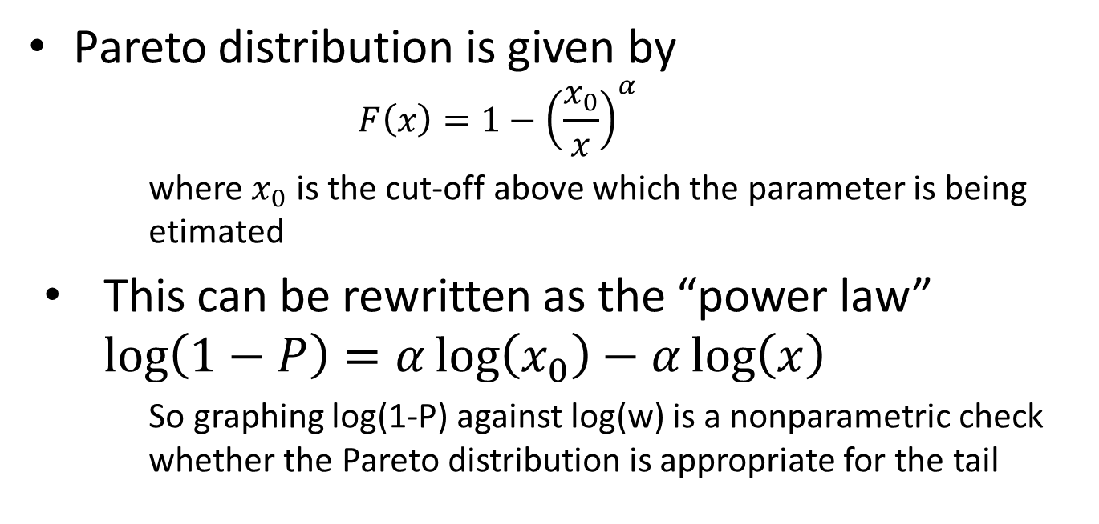
Pareto distribution
Top Earnings
Pareto distribution is given by
$$F\left(x\right)=1−{\left(\frac{x_{0}}{x}\right)}^{α}$$
where $x_{0}$ is the cut-off above which the parameter is being etimated
This can be rewritten as the “power law” $\log\left(1−P\right)=α\log\left(x_{0}\right)−α\log\left(x\right)$
So graphing log(1-P) against log(w) is a nonparametric check whether the Pareto distribution is appropriate for the tail

Slide 23
Position of the top tail
Top Earnings

Slide 24
Distribution within the top tail
Top Earnings

Slide 25
Estimated Pareto coefficients
Top Earnings
 | Cutoff: R4501 (1996) |  |  | Cutoff: R6001 (1996) |  |  | Cutoff: R8001 (1996) |  |  | Cutoff: R2501 (1996)
 | alpha |  | n | alpha |  | n | alpha |  | n | alpha |  | n
95Oct | 1.950 | (0.0376) | 4,236 | 2.003 | (0.0527) | 2,587 | 2.088 | (0.0788) | 1,345 | 1.659 | (0.0180) | 9,536
96Oct | 1.873 | (0.0639) | 1,490 | 1.783 | (0.0841) | 814 | 1.739 | (0.114) | 475 | 1.557 | (0.0284) | 3,781
97Oct | 1.712 | (0.0451) | 2,456 | 1.619 | (0.0556) | 1,396 | 1.520 | (0.0671) | 831 | 1.511 | (0.0224) | 5,999
98Oct | 1.471 | (0.0451) | 1,763 | 1.373 | (0.0510) | 1,075 | 1.373 | (0.0631) | 703 | 1.535 | (0.0297) | 4,175
99Oct | 1.728 | (0.0540) | 2,156 | 1.608 | (0.0657) | 1,264 | 1.567 | (0.0850) | 751 | 1.608 | (0.0282) | 4,990
00Sep | 1.805 | (0.0686) | 2,299 | 1.818 | (0.0959) | 1,352 | 1.625 | (0.124) | 776 | 1.439 | (0.0282) | 5,048
01Sep | 2.138 | (0.0621) | 2,664 | 2.163 | (0.0818) | 1,512 | 1.893 | (0.0897) | 853 | 1.600 | (0.0248) | 5,614
02Sep | 1.914 | (0.0584) | 2,191 | 2.056 | (0.0871) | 1,313 | 2.064 | (0.122) | 718 | 1.576 | (0.0265) | 5,079
03Sep | 2.054 | (0.0549) | 2,569 | 1.993 | (0.0706) | 1,474 | 1.903 | (0.0911) | 785 | 1.584 | (0.0240) | 5,442
04Sep | 2.097 | (0.0709) | 2,490 | 2.099 | (0.0926) | 1,404 | 2.050 | (0.126) | 716 | 1.550 | (0.0306) | 5,088
05Sep | 1.808 | (0.0621) | 2,496 | 2.004 | (0.0920) | 1,549 | 1.850 | (0.109) | 782 | 1.350 | (0.0271) | 5,024
06Sep | 1.857 | (0.0651) | 2,725 | 1.776 | (0.0793) | 1,599 | 2.002 | (0.117) | 869 | 1.351 | (0.0282) | 5,354
07Sep | 1.628 | (0.0918) | 2,357 | 1.687 | (0.119) | 1,850 | 1.772 | (0.155) | 1,009 | 1.334 | (0.0453) | 5,166
Pooled | 1.823 | (0.0140) | 53,154 | 1.846 | (0.0186) | 31,528 | 1.792 | (0.0238) | 17,472 | 1.475 | (0.0064) | 117,647

Slide 26
Summary
Top Earnings
No evidence in the graphs or table that there is a systematic trend for the distribution to flatten out/steepen
Above a cut-off of R4500 the parameter estimates are not that sensitive to the particular cut-off chosen

Slide 27
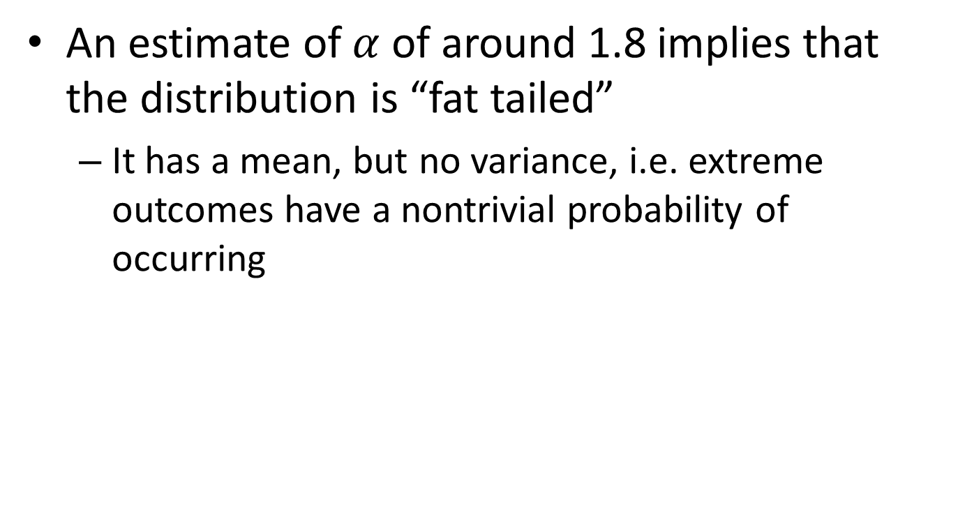
Implications
Top Earnings
An estimate of $α$ of around 1.8 implies that the distribution is “fat tailed”
It has a mean, but no variance, i.e. extreme outcomes have a nontrivial probability of occurring

Slide 28
Example
Top Earnings
Illustrative probabilities in the tail
cut-off (monthly) | prob | numbers
8000 | 1 | 1500000
16000 | 0.287175 | 430762
30000 | 0.092628 | 138942
100000 | 0.010606 | 15909
300000 | 0.001468 | 2202
1000000 | 0.000168 | 252
3000000 | 2.33E-05 | 35
10000000 | 2.66E-06 | 4

Slide 29
Tax statistics
Top Earnings
Cutoff | 100 001 | 200 001 | 300 001 | 400 001 | 500 001
2003 | 1.584 | 1.138 | 1.303 | 1.411 | 1.111
2004 | 1.552 | 1.145 | 1.320 | 1.434 | 1.129
2005 | 1.519 | 1.134 | 1.314 | 1.424 | 1.113
2006 | 1.469 | 1.108 | 1.286 | 1.391 | 1.096
2007 | 1.381 | 1.086 | 1.268 | 1.372 | 1.077
2008 | 1.301 | 1.066 | 1.249 | 1.359 | 1.072
2009 | 1.235 | 1.070 | 1.266 | 1.390 | 1.096

Slide 30
Discussion
Top Earnings
Results in this case are somewhat sensitive to the choice of the cut-off
For some choices there seems to be evidence for the tail to get “fatter”
Change in coverage?
The range of the Pareto estimates (1.5 to 1.1) are noticeably smaller than in the case of labour earnings
Impact of returns on investments? Other forms of compensation?
Some comparative figures for other countries (Levy & Levy):
US 1.35, UK 1.06, France 1.83

Slide 31
Where to now?
REDI 3x3

Slide 32
PALMS
Top Earnings
We will update PALMS next year
There seems to be a need for more extensive training
Use of the “bracket weights”
Use of the multiple imputation dataset
Further work on data quality adjustments

Slide 33
TAX DATA
Top Earnings
Hopefully we’ll be able to redo the “top tails” analyses on unit record data
Make a “synthetic” version available

