Slide 1
Why Didn’t Inequality Decline in South Africa?
Vimal Ranchhod
Murray Leibbrandt
SALDRU, UCT
4th November 2014
REDI3x3 Income Distribution Workshop

Slide 2
Overview
Levels and Trends in inequality
‘Causes’ of inequality
Empirical findings
Future research
Conclusion

Slide 3
Levels and trends

Slide 4
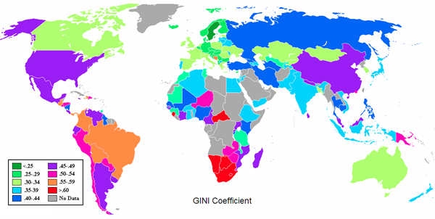
GINI coefficients: CIA data (2011)

Slide 5
 |  |  |  | Household income share
 | Gini | Year | Gini Rank | top 10% | bot. 10% | ratio
Botswana | 0.63 | 1993 | 2 | - | - | -
South Africa | 0.631 | 2005 | 3 | 51.70% | 1.20% | 43.08
Swaziland | 0.504 | 2001 | 20 | 40.10% | 1.70% | 23.59
US | 0.45 | 2007 | 41 | 30% | 2% | 15.00
UK | 0.4 | 2009 | 60 | 28.50% | 2.10% | 13.57
Germany | 0.27 | 2006 | 126 | 24% | 3.60% | 6.67
Japan | 0.376 | 2008 | 76 | 27.50% | 1.90% | 14.47
Brazil | 0.519 | 2012 | 17 | 42.90% | 0.80% | 53.63
Russia | 0.417 | 2011 | 52 | 42.50% | 5.70% | 7.46
India | 0.368 | 2004 | 78 | 31.10% | 3.60% | 8.64
China | 0.474 | 2012 | 29 | - | - | -
Data source: World Factbook (CIA)
URL https://www.cia.gov/library/publications/the-world-factbook/
Accessed on 1st September 2013

Slide 6
Background (1)
High inequality in SA is a long run phenomenon.
Post-apartheid levels are consistently high, and have probably increased over the past twenty years.
Several researchers; Leibbrandt et al (2001), Hoogeveen and Ozler (2005), Leibbrandt, Levinsohn and McCrary (2010), Leibbrandt, Woolard, Finn and Argent (2010), van der Berg and Louw (2004), van der Berg, Louw and Yu (2008) and Yu (2010)...(and others)
Various estimates of inequality, but a useful range for Gini coefficient would be about 0.65 – 0.70

Slide 7
Background (2)
SA post 1994 has slow but relatively stable growth rates.
Poverty rates remain high ( about 50%)
Small but growing middle class
General depreciation of currency in nominal terms
Mostly stable fiscal situation, reduction of national debt, inflation generally in targeted bandwidth (or close thereto)

Slide 8
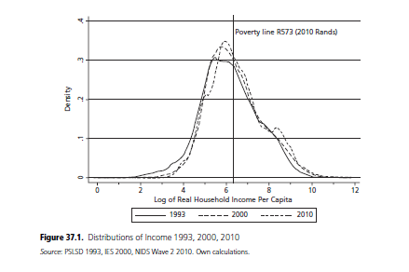

Slide 9
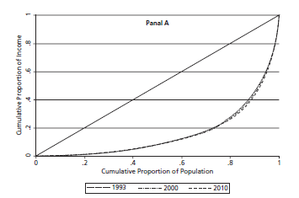
Lorenz Curves: 1993, 2000, 2010

Slide 10
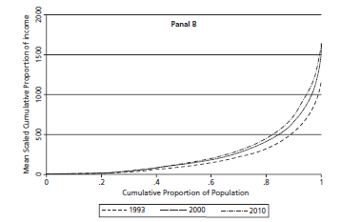
Generalized Lorenz Curves 1993, 2000, 2010

Slide 11
Gini Coefficients 1993 and 2010
Gini | 1993 | 2010
Overall | 0.674 | 0.696
Deciles 1-9 | 0.524 | 0.525
Deciles 1-8 | 0.450 | 0.438
Decile 10 | 0.327 | 0.351
Deciles 1-4
With grants | 0.338 | 0.297
W/Ogrants | 0.491 | 0.604

Slide 12
Causes of inequality

Slide 13
Sources of Income Inequality
Differences in productive endowments (Health, skills etc at birth)
Differences in the development of productive endowments/skills, eg. Schooling, transfer of skills from parents
Differences in effort
The way a society is structured
Laws, property rights, access to markets
Bargaining power
Group level discrimination (Gender, race)

Slide 14
The evolution of Inequality
Kuznets’ theory:
Skilled biased technological change
Inequality Traps
Piketty’s ‘Capital in the 21st Century’
Economic
Political
Social

Slide 15
Inequality Traps
Economic inequality traps
Rich and poor face different costs of investments
Rich will invest while poor will not be able to
Rich will get high returns while poor will not
Leads to persistence of inequality
Example in SA would be good quality schools
Political inequality traps
Rent seeking and lobbying can distort the way markets operate in favour of the wealthy and the politically connected (Could be the same people)
Poor remain poor, rich remain rich

Slide 16
Inequality Traps
Social Inequality traps
Neighbourhood stratification makes wealthier areas more productive.
Think of schools, infrastructure, safety, libraries, role models, peer effects, gangs
Rich remain rich and poor remain poor
In the inequality traps literature, the high inequality state is not efficient

Slide 17
Sources of trends in inequality in SA
Labour market – both unemployment and wage distribution
Cash transfers (part of more general issue of taxes and expenditures)
Education
Attainment
Returns to education

Slide 18
Sources of Income Inequality in SA
Tax systems (progressive or regressive)
Transfers from the state
Grants
Public goods
Differences in wealth
Differences in inheritances

Slide 19
Empirical findings

Slide 20
Summary (1)
“Inequality in South Africa and Brazil: Can We Trust the Numbers?”. (Finn and Leibbrandt)
Methodological paper assessing whether inequality measures from these countries can be compared.
Finds that inequality is unambiguously higher in South Africa.
“The Distribution of Wealth in the National Income Dynamics Study Wave 2”. (Daniels, Finn and Musundwa)
Analyse the distribution of assets and liabilities and compares the inequality of wealth to the inequality of income in the country using wave 2 of NIDS data.
Wealth inequality is much (MUCH) higher than income inequality.

Slide 21
Summary (2)
“Post-apartheid Changes in South African Inequality” (Finn, Leibbrandt and Woolard)
Explores dimensions/components of income inequality and changes from 1993 (PSLSD) to 2008 (NIDS Wave 1).
Labour market was and remains key to understanding inequality.
“Trends in South African Income Distribution and Poverty Since the Fall of Apartheid”. (Finn, Leibbrandt and Woolard)
Income inequality has increased on aggregate and within races. (1993 – 2000 – 2008).
Race based redistribution unlikely to be sufficient to decrease inequality.
Social grants became more important, affect poverty but small effect on inequality.
Substantial improvements in non-monetary well-being (access to electricity, housing, water etc.)

Slide 22
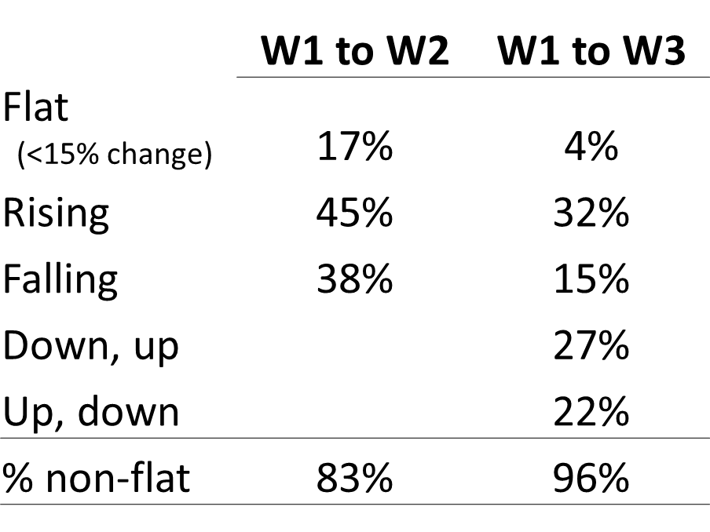
Income Mobility Evidence from three waves of NIDS

Slide 23
Income Sources and Inequality

Slide 24
Declines in returns to Inc. Sec. in 2000s – these are now disequalizing.

Slide 25
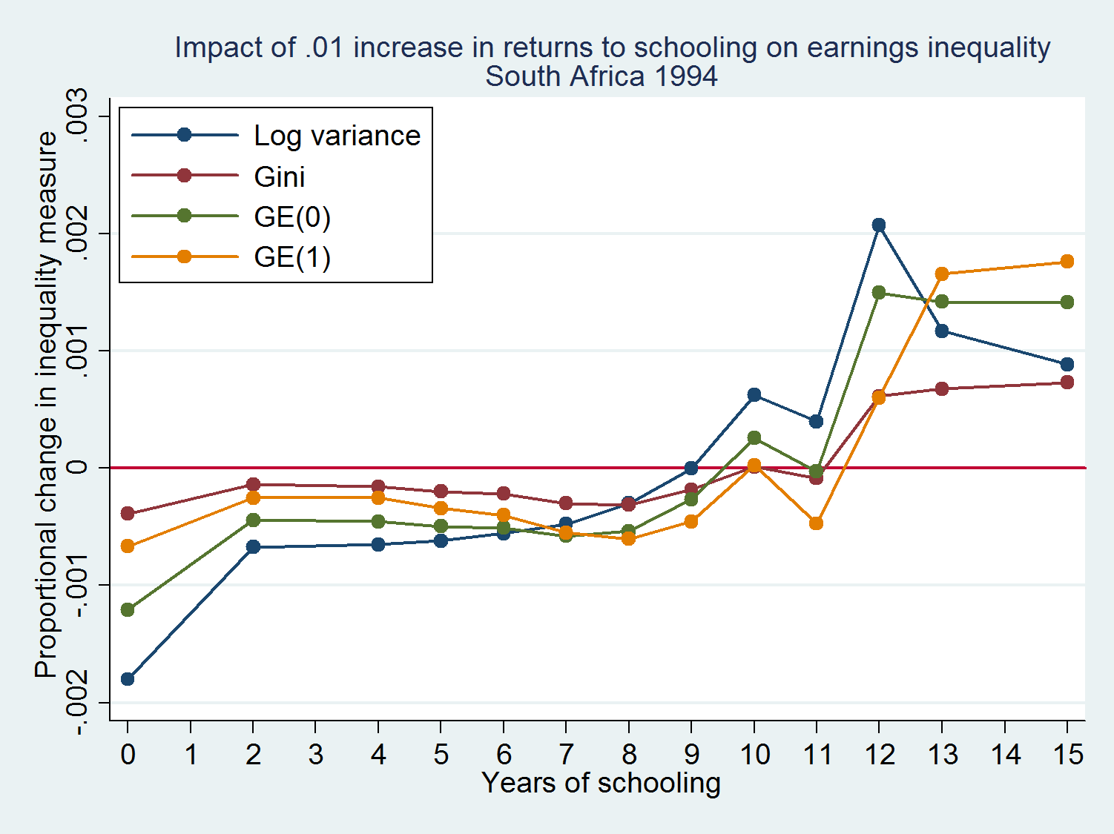
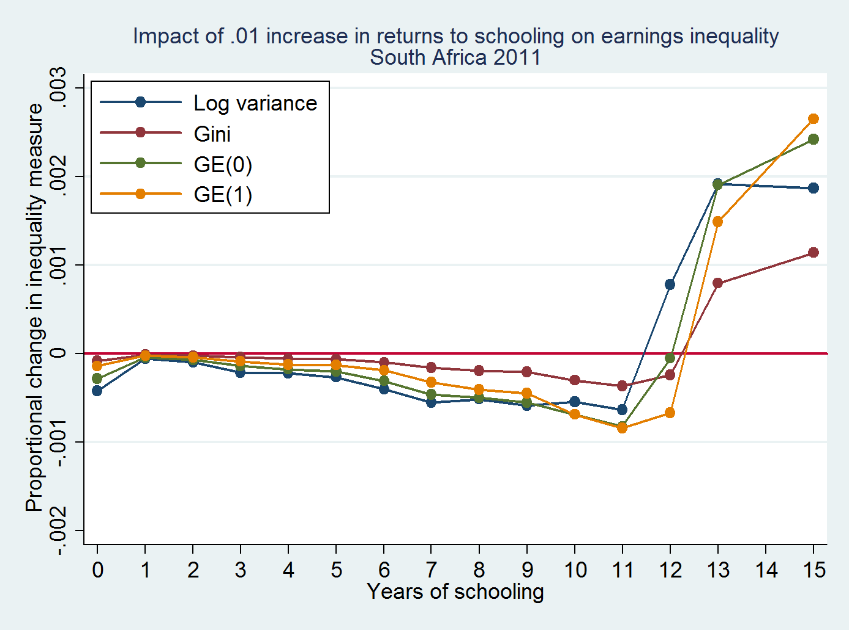
Increases in returns to schooling at grade 10 would have been disequalizing in 1994, but they would be equalizing in 2011.
Increases in returns to “grade 15” are more disequalizing in 2011 than they were in 1994

Slide 29
Table 2: Mean of some tertiary qualification in NIDS
(by age and income quintile)
 |  | Per capita household income quintiles
age | 1 | 2 | 3 | 4 | 5 | Total
18 | 0.000 | 0.000 | 0.007 | 0.000 | 0.000 | 0.001
19 | 0.000 | 0.041 | 0.004 | 0.005 | 0.037 | 0.016
20 | 0.050 | 0.036 | 0.038 | 0.054 | 0.212 | 0.070
21 | 0.035 | 0.106 | 0.034 | 0.043 | 0.290 | 0.087
22 | 0.035 | 0.063 | 0.026 | 0.117 | 0.345 | 0.101
23 | 0.005 | 0.089 | 0.007 | 0.130 | 0.233 | 0.084
24 | 0.097 | 0.123 | 0.098 | 0.157 | 0.314 | 0.151
Total | 0.027 | 0.058 | 0.031 | 0.075 | 0.191 | 0.068

Slide 30
Future research
Effect of demography on inequality
Credit markets, access and costs
Why so little entrepreneurship?
Costs of banking
Top incomes
Labour market: Unemployment, wage dispersion, regulations, discrimination
Pre-labour market differentials, including social and psychological components

Slide 31
Conclusion
We live in the most unequal region of the world
Our inequality is chronically high and stable
This is both unjust (depending on how one defines justice) and probably inefficient
We could probably do better, i.e. Lower inequality and simultaneously enhance our economic performance
There are many different ways to approach this complex problem, although unlikely to have a single solution.
With time, we can unravel components of this process and move towards better and more informed understanding and policy.

