Slide 1
Measuring Inequality by Asset Indices: the case of South Africa
Martin Wittenberg
REDI 3x3 presentation

Slide 2
Overall argument: the negative
Main methods of generating asset indices (PCA, Factor Analysis, MCA) look for correlations between different “assets”
  Latent variable interpretation: what is common to the assets must be “wealth”
This breaks down when there are assets that are particular to sub-groups (rural areas) such as livestock
  These assets are typically negatively correlated with the other assets
Resulting index will violate the assumption that people with a lower score always have less “stuff” than people with a higher score

Slide 3
Overall argument: the positive
It is possible to construct indices in a way which sidesteps these issues
In the process it is possible to give a cardinal interpretation to the indices, i.e. we can estimate inequality measures with them
When applying these measures to South African data we find that "asset inequality" has decreased markedly between 1993 and 2008
  This contrasts with the money-metric measures
  If incomes rise across the board then asset holdings with a static schedule will show increases in attainment while inequality will stay constant
BUT
Creation of asset indices should proceed carefully -- examining whether the implied coefficients make sense

Slide 4
Motivation
Asset indices have become very widely used in the development literature, particularly with the release of the DHS wealth indices
  13 900 "hits" for "DHS wealth index" on Google Scholar
  2 434 Google Scholar citations of the Filmer and Pritchett article
  591 Google Scholar citations of the Rutstein and Johnson (DHS wealth index) paper
Use of these indices has been externally validated (e.g. against income)
But in at least some cases they are internally inconsistent (as we will show)
Asset indices have proved extremely useful in broadly separating "poor" from the "rich“
Cannot use indices to measure inequality or changes in inequality -- yet in some cases assets is all we have

Slide 5
Literature: Principal Components
The Filmer and Pritchett (2001) paper argued that the first principal component of a series of asset variables should be thought of as "wealth".
This interpretation has underpinned its adoption by the DHS as the default approach for creating the “DHS wealth index”

Slide 6
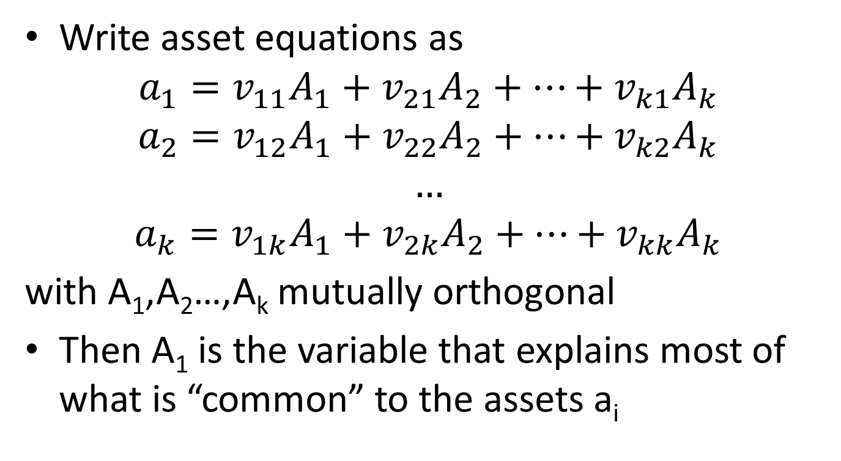
Latent variable interpretation
Write asset equations as
$$a_{1}=v_{11}A_{1}+v_{21}A_{2}+…+v_{k1}A_{k}$$
$$a_{2}=v_{12}A_{1}+v_{22}A_{2}+…+v_{k2}A_{k}$$
$$…$$
$$a_{k}=v_{1k}A_{1}+v_{2k}A_{2}+…+v_{kk}A_{k}$$
with A₁,A₂…,A_{k} mutually orthogonal
Then A₁ is the variable that explains most of what is “common” to the assets a_{i}

Slide 7
The mechanics
Variables are standardized (de-meaned, divided by their standard deviations)
The scoring coefficients are given by the first eigenvector of the correlation matrix
Consequences:
Asset indices have mean zero (i.e. can’t use traditional inequality measures on them)
The implicit “weights” on each of the assets are a combination of the score and the standardization
  Generally not reported/interrogated

Slide 8
Starting from scratch
Desirable properties:
  Asset index should be monotonic (people that have more, should be ranked higher)
  Somebody who has no assets should get a score of zero
    Implies that we are not including “bads”
  Approach should work both with binary and with continuous data

Slide 9
Thinking about inequality using binary variables
Many of the traditional “thought experiments” don’t work in this context:
  e.g. there is no way to do a transfer from a richer to a poorer person while keeping their ranks in the distribution unchanged
  It is impossible to scale all holdings up by an arbitrary constant

Slide 10
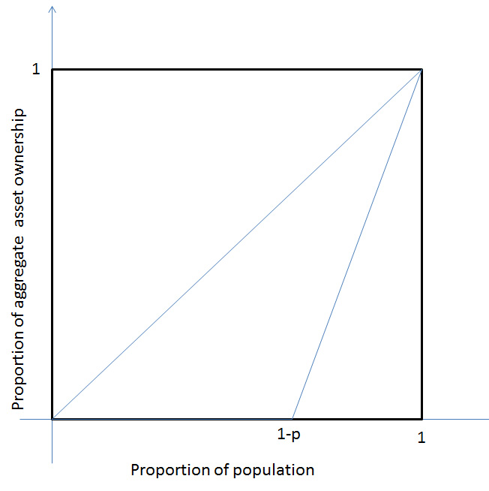
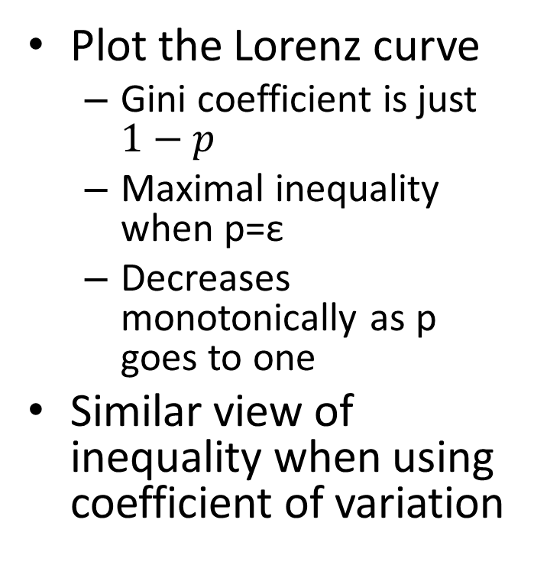
The case of one dummy variable
Plot the Lorenz curve
  Gini coefficient is just $1−p$
  Maximal inequality when p=ε
  Decreases monotonically as p goes to one
Similar view of inequality when using coefficient of variation

Slide 11
Two binary variables
One additional complication that occurs when you have more than one variable is dealing with the case of a “correlation increasing transfer”
  e.g. the asset holdings (1,0) and (0,1) versus (0,0) and (1,1)
Most people would judge the second distribution to be more unequal than the first

Slide 12
PCA index
We can derive expressions of the value of the PCA index as a function of
  the proportions p₁ and p₂ who hold assets 1 and 2 respectively
  and p₁₂ the fraction who hold both
The range (and the variance) of the index shows a U shape with minimum near p₁ (the more commonly held asset)
  Unbounded near 0 and 1

Slide 13
More critically
The assets will be negatively correlated whenever p₁₂≤p₁p₂
In this case one of the assets will score a negative weight in the index

Slide 14
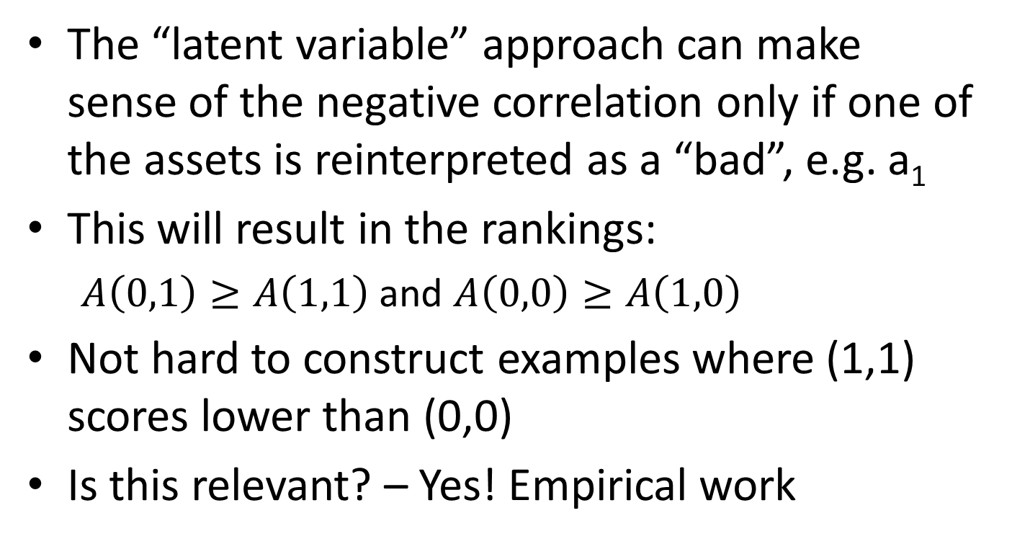
Why is this the case?
The “latent variable” approach can make sense of the negative correlation only if one of the assets is reinterpreted as a “bad”, e.g. a₁
This will result in the rankings:
  $A\left(0,1\right)≥A\left(1,1\right)$ and $A\left(0,0\right)≥A\left(1,0\right)$
Not hard to construct examples where (1,1) scores lower than (0,0)
Is this relevant? – Yes! Empirical work

Slide 15
Banerjee’s “Multidimensional Gini”
Create an “uncentered” version of the principal components procedure:
  Divide every variable by its mean (in the binary variable case p_{i})
  This makes the procedure “scale independent”
    In the continuous variable case
  It has the side-effect of paying more attention to scarce assets in the binary variable case
    BUT this will also prove troublesome in some empirical cases
  Then extract the first principal component of the cross-product matrix
Calculate Gini coefficient on this index

Slide 16
What does this do?
This procedure is guaranteed to give non-negative scores
Banerjee proves that the Gini calculated in this way obeys (using continuous variables) obeys all the standard inequality axioms
PLUS it will show an increase in inequality if a “correlation increasing transfer’’ is effected

Slide 17
In the case of asset indices
It is guaranteed to give an asset index that obeys the principle of monotonicity
It will have an absolute zero
And it can be used to calculate Gini coefficients even when all variables are binary variables.

Slide 18
Application to the DHS wealth index
VARIABLES | DHS WI | UC PCA | UC PCA2 | PCA | PCA2 | MCA | FA
water in house | 0.252*** | 0.209 | 0.565 | 0.708 | 0.707 | 0.329 | 0.289
electricity | 0.180*** | 0.0814 | 0.220 | 0.663 | 0.657 | 0.300 | 0.265
radio | 0.0978*** | 0.0515 | 0.140 | 0.467 | 0.477 | 0.206 | 0.113
television | 0.160*** | 0.101 | 0.273 | 0.678 | 0.680 | 0.312 | 0.301
refrigerator | 0.179*** | 0.136 | 0.369 | 0.735 | 0.738 | 0.343 | 0.413
bicycle | 0.0923*** | 0.600 | 1.401 | 0.490 | 0.501 | 0.233 | 0.137
m.cycle | 0.169*** | 52.57 |  | 0.788 | 0.821 | 0.412 | 0.193
car | 0.175*** | 0.490 | 1.202 | 0.766 | 0.777 | 0.368 | 0.320
rooms | 0.0102*** | 0.0176 | 0.0482 | 0.0977 | 0.105 | CAT | 0.0221
telephone | 0.196*** | 0.378 | 0.989 | 0.813 | 0.818 | 0.387 | 0.397
PC | 0.210*** | 4.984 | 14.42 | 0.967 | 0.982 | 0.481 | 0.296
washing machine | 0.203*** | 0.654 | 1.696 | 0.870 | 0.877 | 0.421 | 0.452
donkey/horse | -0.0880*** | 2.836 | 4.523 | -0.293 |  | -0.118 | -0.0849
sheep/cattle | -0.118*** | 0.291 | 0.509 | -0.375 |  | -0.156 | -0.0909
Observations | 11,666 | 12,136 | 12,136 | 12,136 | 12,136 | 12,136 | 12,136
R-squared | 0.999 | 1.000 | 1.000 | 1.000 | 1.000 | 1.000 | 1.000

Slide 19
Comparing the PCA 2 and UC PCA2 rankings
Quantiles of UC PCA2 | Quantiles of PCA 2
 | 1 | 2 | 3 | 4 | 5 | Total
1 | 2 368 | 482 | 0 | 0 | 0 | 2 850
2 | 530 | 1 145 | 748 | 0 | 0 | 2 423
3 | 34 | 429 | 1 277 | 586 | 0 | 2 326
4 | 0 | 66 | 275 | 1 463 | 399 | 2 203
5 | 175 | 104 | 55 | 84 | 1 912 | 2 330
Total | 3 107 | 2 226 | 2 355 | 2 133 | 2 311 | 12 132

Slide 20
Comparing the rankings
 | DHS WI | PCA | PCA 2 | MCA | FA | UC PCA | UC PCA 2
DHS WI | 1
PCA | 0.9435 | 1
PCA 2 | 0.9337 | 0.9974 | 1
MCA | 0.94 | 0.999 | 0.9973 | 1
FA | 0.9449 | 0.9968 | 0.9952 | 0.9959 | 1
UC PCA | 0.3059 | 0.3862 | 0.3995 | 0.3956 | 0.362 | 1
UC PCA 2 | 0.6247 | 0.7391 | 0.7559 | 0.747 | 0.7234 | 0.4539 | 1

Slide 21
Proportion poor (bottom 40%)
 |  | Linearized
Over | Mean | Std. Err. | [95% Conf. Interval]
DHS
capital, large city | 0.098 | 0.013 | 0.072 | 0.123
small city | 0.178 | 0.024 | 0.131 | 0.225
town | 0.204 | 0.031 | 0.142 | 0.265
countryside | 0.720 | 0.020 | 0.681 | 0.759
PCA 2
capital, large city | 0.146 | 0.014 | 0.119 | 0.173
small city | 0.220 | 0.021 | 0.179 | 0.261
town | 0.291 | 0.032 | 0.229 | 0.353
countryside | 0.648 | 0.019 | 0.610 | 0.686
UC PCA 2
capital, large city | 0.198 | 0.015 | 0.169 | 0.227
small city | 0.275 | 0.022 | 0.232 | 0.317
town | 0.372 | 0.033 | 0.308 | 0.437
countryside | 0.597 | 0.016 | 0.566 | 0.628

Slide 22
Asset inequality by area
Group | Estimate | STE | LB | UB
1: capital, large city | 0.566 | 0.009 | 0.549 | 0.583
2: small city | 0.538 | 0.014 | 0.511 | 0.566
3: town | 0.569 | 0.023 | 0.524 | 0.614
4: countryside | 0.609 | 0.014 | 0.582 | 0.636
Population | 0.623 | 0.007 | 0.610 | 0.636

Slide 23
South Africa 1993-2008

Slide 24
Asset holdings
 |  | Linearized
Over | Mean | Std. Err. | [95% Conf. Interval]
electricity 1993 | 0.459 | 0.024 | 0.411 | 0.507
2008 | 0.779 | 0.020 | 0.740 | 0.818
Piped water 1993 | 0.506 | 0.027 | 0.454 | 0.559
2008 | 0.697 | 0.025 | 0.648 | 0.746
radio 1993 | 0.811 | 0.008 | 0.796 | 0.826
2008 | 0.694 | 0.012 | 0.672 | 0.717
TV 1993 | 0.477 | 0.018 | 0.441 | 0.512
2008 | 0.703 | 0.017 | 0.671 | 0.736
Fridge 1993 | 0.399 | 0.020 | 0.360 | 0.438
2008 | 0.609 | 0.020 | 0.569 | 0.648
Motor 1993 | 0.247 | 0.016 | 0.215 | 0.279
2008 | 0.220 | 0.018 | 0.184 | 0.256
Livestock 1993 | 0.110 | 0.011 | 0.089 | 0.132
2008 | 0.100 | 0.011 | 0.078 | 0.122
Land line 1993 | 0.242 | 0.018 | 0.206 | 0.278
2008 | 0.143 | 0.015 | 0.114 | 0.172
Cell phone 2008 | 0.807 | 0.011 | 0.786 | 0.828
Any phone 1993 | 0.242 | 0.018 | 0.206 | 0.278
2008 | 0.827 | 0.010 | 0.808 | 0.847

Slide 25
South Africa - Assets

Slide 26
Why the difference?
Incomes have increased across the board
  Inequality stayed constant
Asset register, however, is fixed:
  Higher proportions of South Africans have access to these
  Hence this measure goes down
The two methods really ask different questions
  Asset inequality measure looks at the gap between the “haves” and the “have nots”
    Is scale dependent
  Income inequality looks at the distribution of incomes, where essentially everyone has something
    Is scale independent

